Slide 1
Direct Manipulation and Immersive Environments
Ying shen
School of software engineering
Tongji university

Slide 2
Outline
Introduction
What is direct manipulation
Some examples
2D and 3D interfaces
Teleoperation and presence
Augmented and virtual reality

Slide 3
Outline
Introduction
What is direct manipulation
Some examples
2D and 3D interfaces
Teleoperation and presence
Augmented and virtual reality

Slide 4
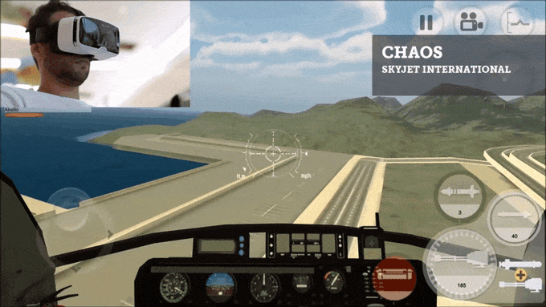
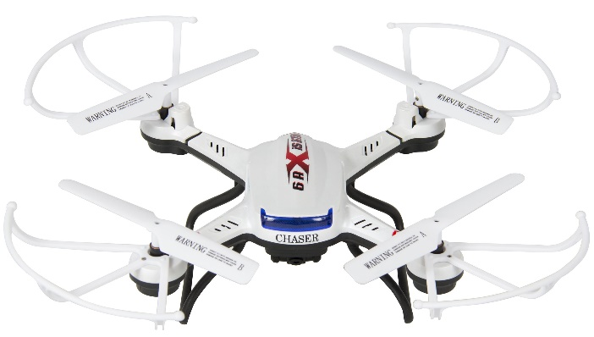
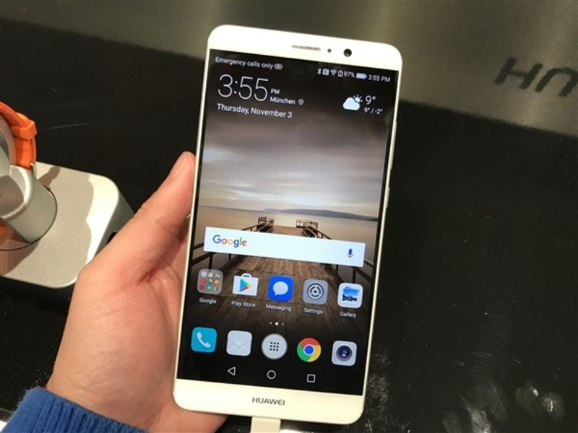
Introduction
The central ideas in satisfying interfaces are
Visibility of the objects and actions of interest
Rapid, reversible, incremental actions
And replacement of typed commands by a pointing action
Direct-manipulation ideas are at the heart of many non-desktop interfaces.
Game gloves
Fly drone
Mobile devices
Notes:
The enthusiastic users have positive feelings:
Mastery of the interface
Competence in performing tasks
Ease in learning originally and in assimilating advanced features
Confidence in the capacity to retain mastery over time
Enjoyment in using the interface
Eagerness to show off the interface to novices
Desire to explore more powerful aspects
CaptoGlove: https://www.bilibili.com/video/BV12x411S7D7
Force Glove

Slide 5
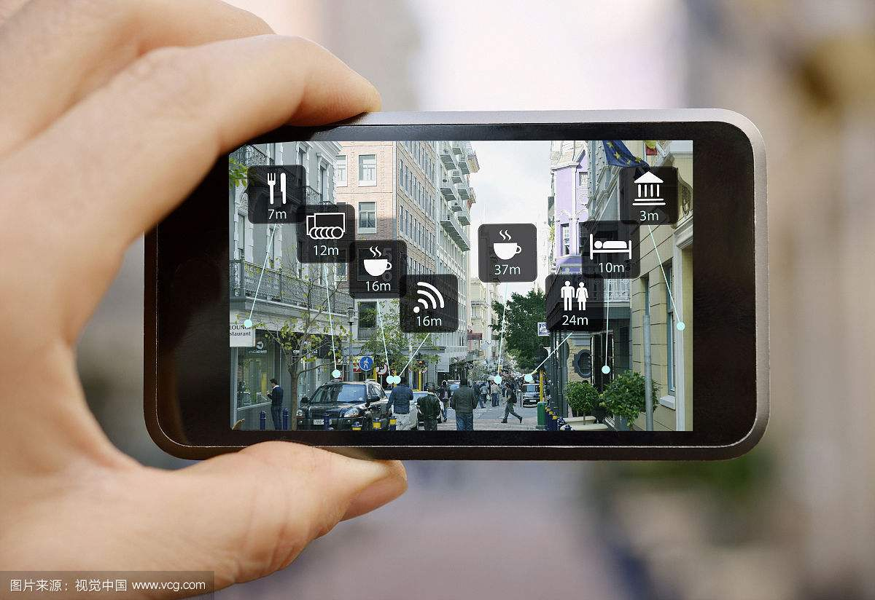
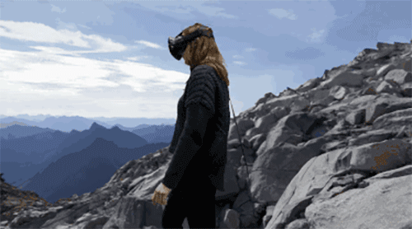
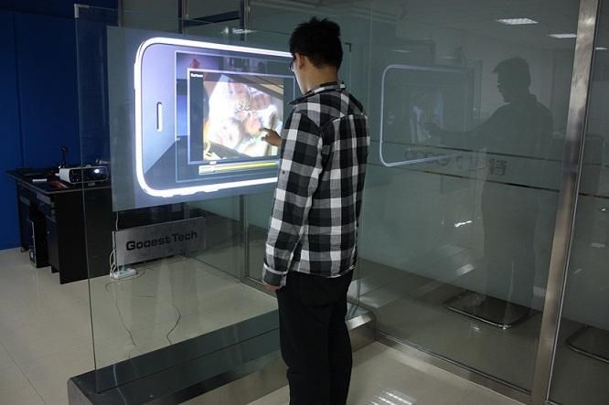
Introduction
New concepts of direct manipulation include
Virtual reality
Augmented reality
Touchable UI
AR
VR
Touchable UI

Slide 6
Outline
Introduction
What is direct manipulation
Some examples
2D and 3D interfaces
Teleoperation and presence
Augmented and virtual reality

Slide 7
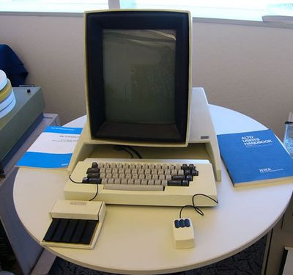
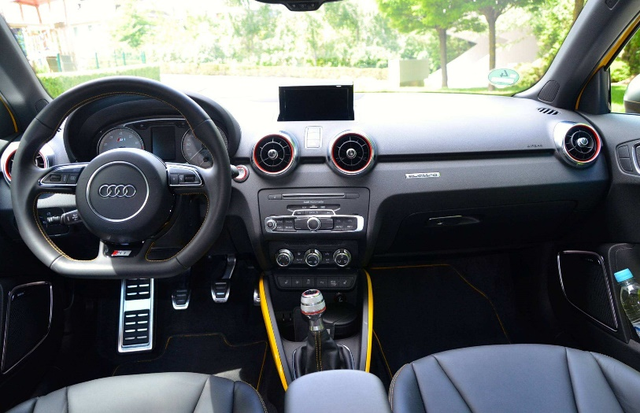
What is direct manipulation?
Direct manipulation was introduced in the early days of Xerox PARC.
An example of direct manipulation is driving an automobile.
You can try to turn a car by typing a command or selecting “turn left 30 degrees” from a menu
Xerox PARC
Driving a car
Notes:
The graceful interaction is due to the increasingly elegant application of direct manipulation.

Slide 8
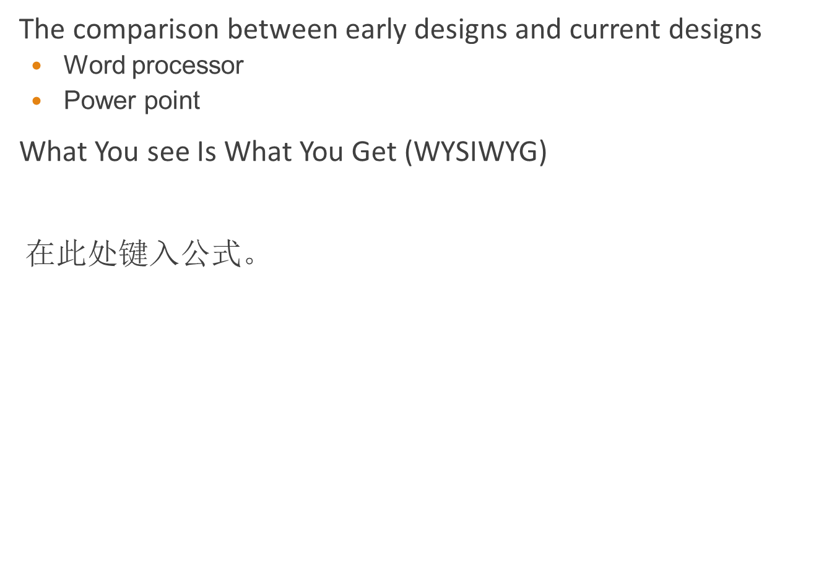
What is direct manipulation?
The comparison between early designs and current designs
Word processor
Power point
What You see Is What You Get (WYSIWYG)
Notes:
输入：$\sqrt{a^{2}+b^{2}}$

Slide 9

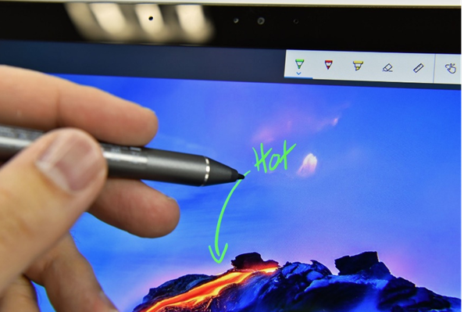
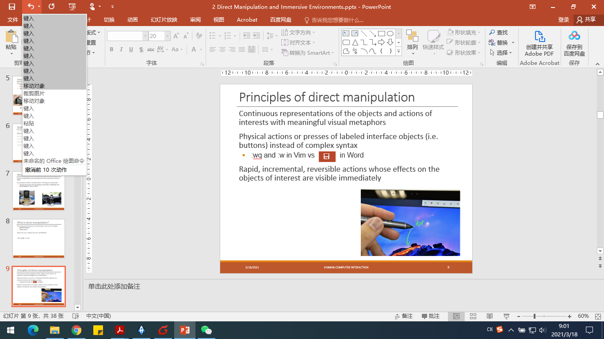
Principles of direct manipulation
Continuous representations of the objects and actions of interests with meaningful visual metaphors
Physical actions or presses of labeled interface objects (i.e. buttons) instead of complex syntax
:wq and :w in Vim vs in Word
Rapid, incremental, reversible actions whose effects on the objects of interest are visible immediately

Slide 10
Advantages of direct manipulation
Novices can learn basic functionality quickly
Experts can work rapidly
Knowledgeable intermittent users can retain operational concepts
Error messages are rarely needed
Users an immediately see operation results
Users experience less anxiety
Users gain a sense of confidence and mastery

Slide 11
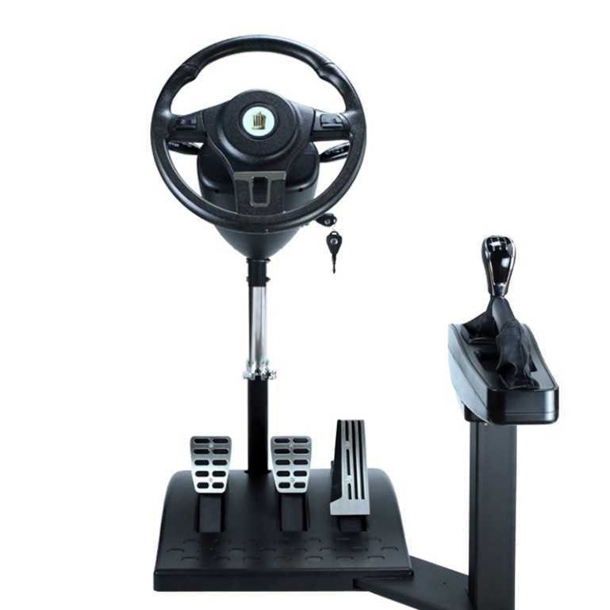
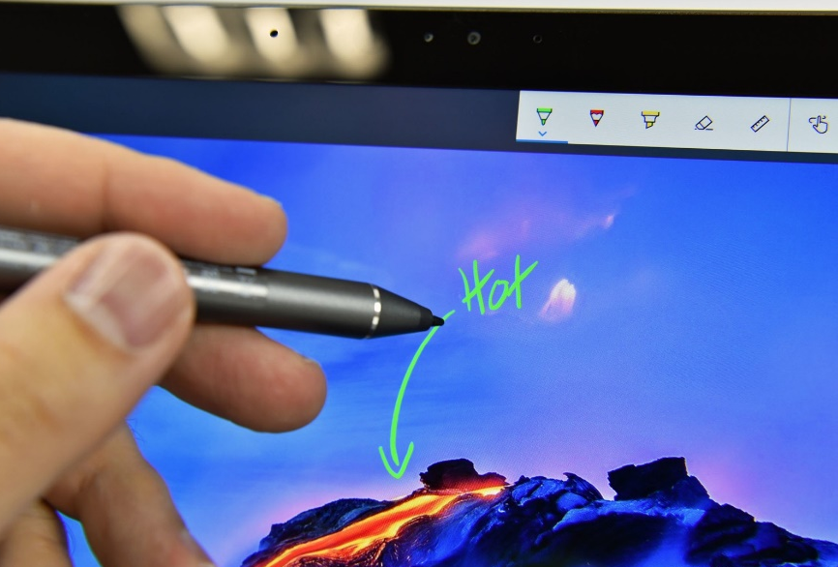
Translational distances
Choose suitable metaphors to represent actions and objects.
Using familiar metaphors makes the learning process easier

Slide 12
Translational distances
Translational distance
Strength of metaphors
Level of indirectness
Examples of translation distances
Weak – Early video game controllers
Medium – touchscreens, multi-touch
Strong – data glove, gesturing, manipulating tangible objects
Immersive – virtual reality

Slide 13
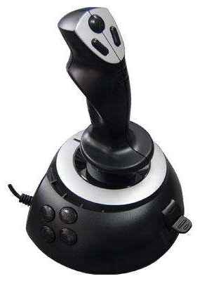

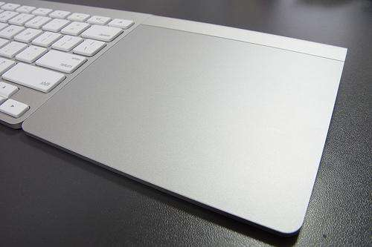
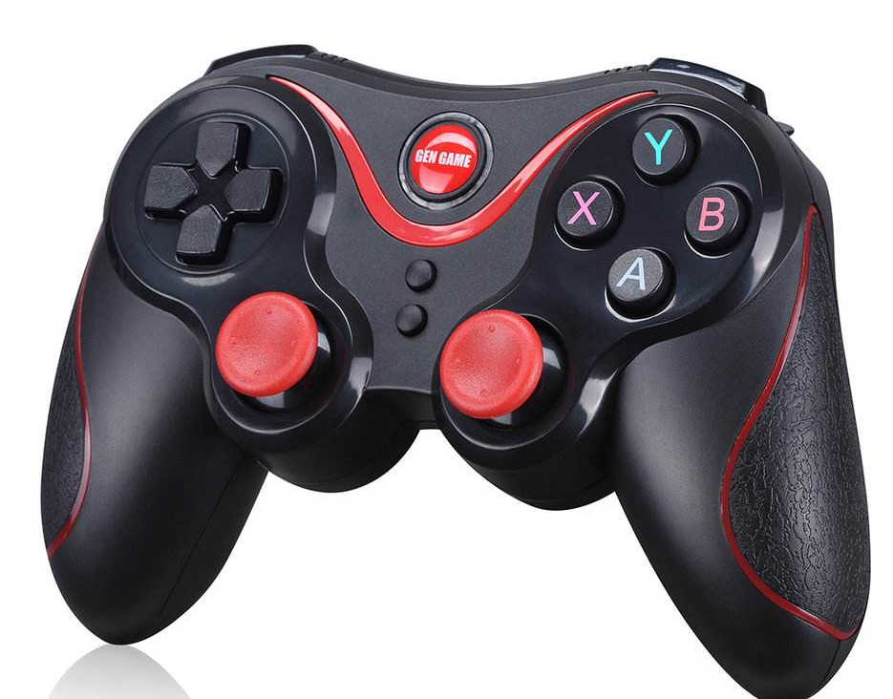
Translational distances
Weak direct manipulation
Basic direct manipulation
Keyboard, mouse, trackpad, joystick, etc
Translational difference is large
Mouse
Trackpad
Joystick

Slide 14
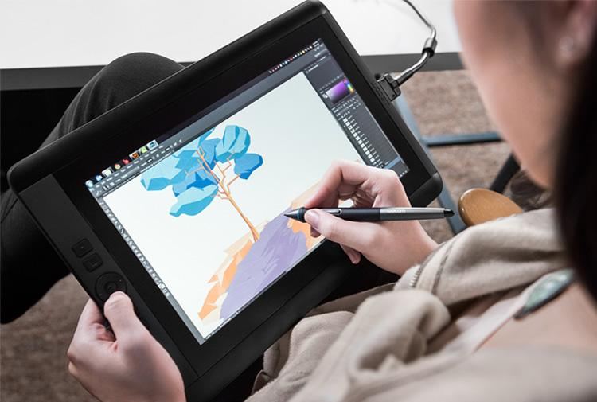
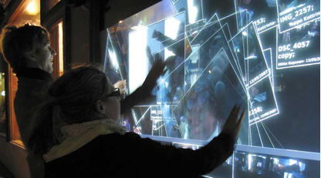
Translational distances
Medium direct manipulation
Reduce the translational distance
Users can touch, move, and grabs the entities on the screen
Touchscreens: mobile, kiosk, and desktop
Limited by the screen
Some actions are intuitive, but others should be learned

Slide 15
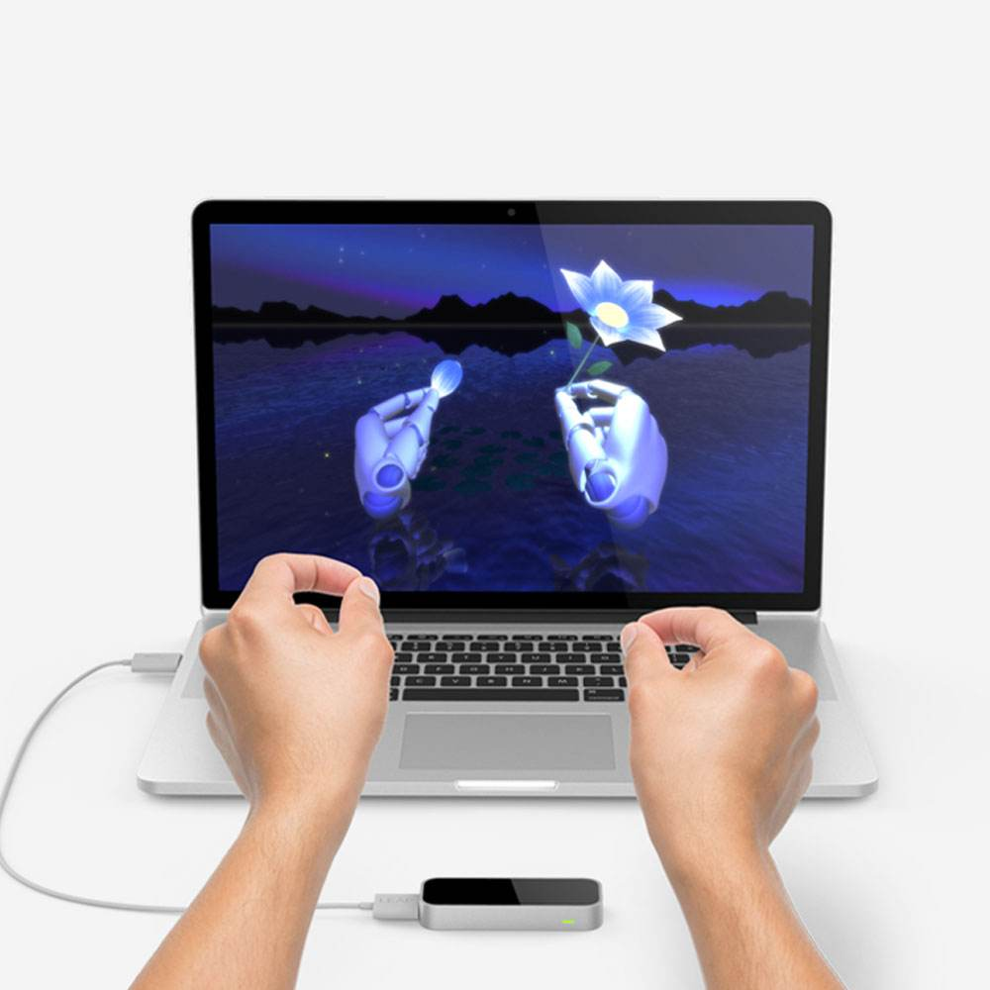
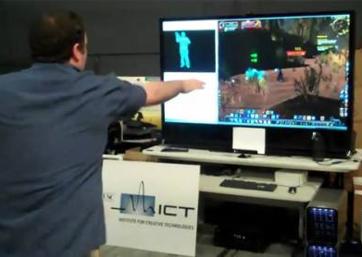
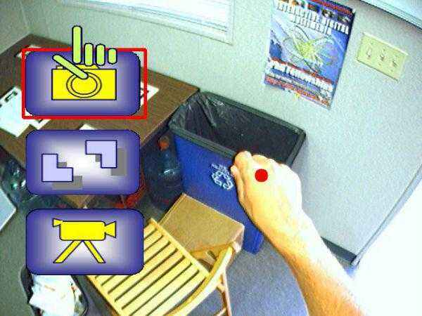
Translational distances
Strong direct manipulation
Involves actions with different body parts, e.g. hand, foot, head
Place hand/foot/head “virtually” inside the physical space
Users can grasp, throw, drop, manipulate, and so forth
Limited by the spaces
Immersive direct manipulation
Combined with virtual reality
The scenery changes when user moves

Slide 16
Problems with direct manipulation
For vision-impaired users, command languages are more suitable than GUI
But screen readers, speech-enabled devices, page readers, and audio designs can compensate the drawback
Direct manipulation designs may consume valuable screen space
Users must learn the meanings of visual representations and graphic icons
Experienced users prefer typing commands
Keyboard is more effective than mouse
A finger pointing at a device may partially block the display
Some direct-manipulation principles are difficult to realize

Slide 17
Continuing evolution
A successful direct-manipulation interface must present an appropriate representation or model of reality
Direct Manipulation
Advantages
Visually presents task concepts
Allows easy learning
Allows easy retention
Allows errors to be avoided
Encourages exploration
Affords high subjective satisfaction
Disadvantages
May hard to program
Accessibility requires special attention
Notes:
A case study

Slide 18
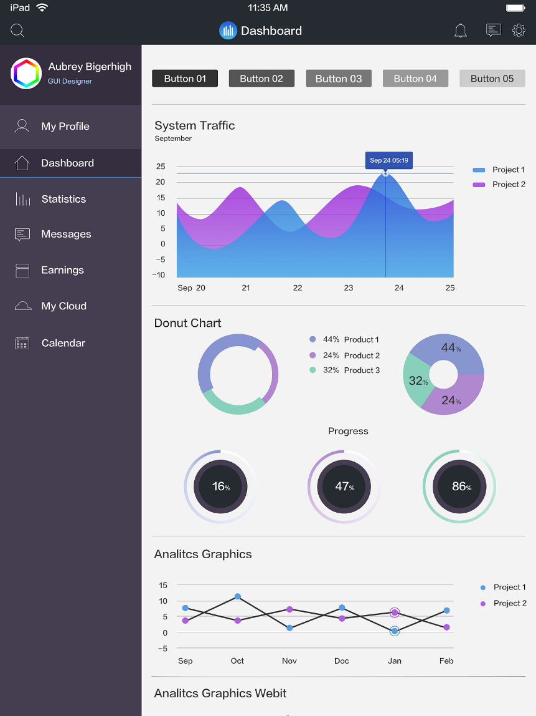
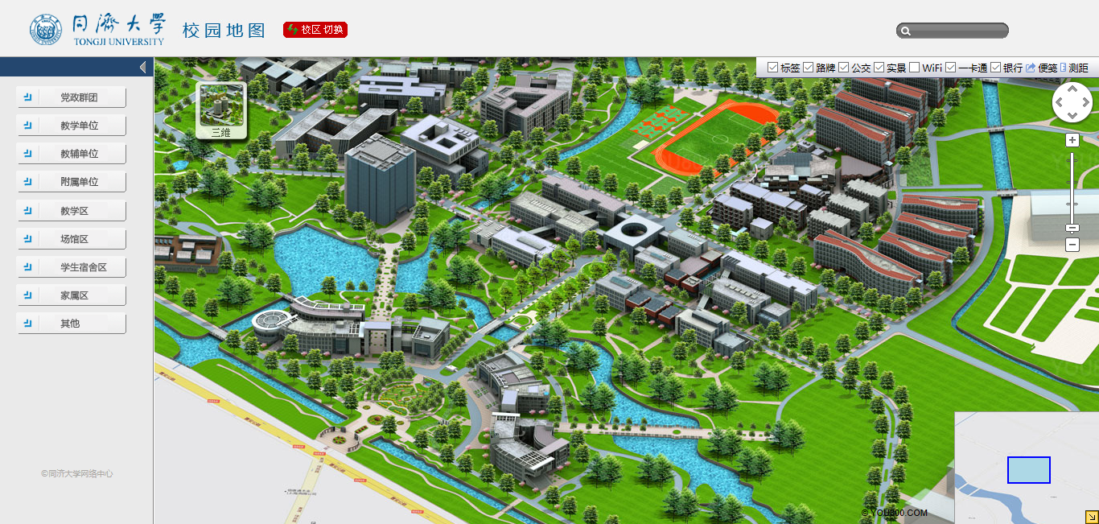
Continuing evolution
Dashboard, Virtual maps
Goal: Comprehensible interfaces that enable rapid learning, predictable and controllable actions, and appropriate feed-back to confirm progress
Notes:
Direct manipulation has the power to attract users because it is rapid, and even enjoyable. If actions are simple, reversibility is ensured, retentions easy, anxiety recedes, users feel in control, and satisfaction flows in.
http://realityeditor.org/

Slide 19
Outline
Introduction
What is direct manipulation
Some examples
2D and 3D interfaces
Teleoperation and presence
Augmented and virtual reality

Slide 20
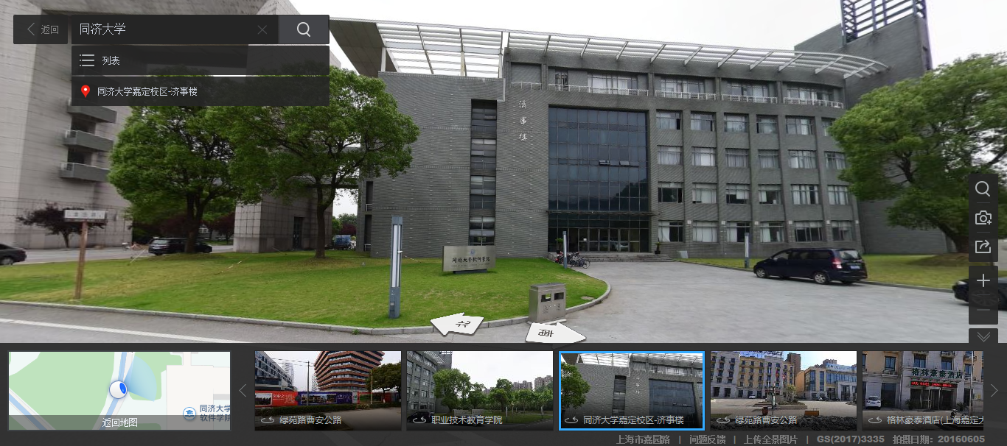
Geographical systems including GPS
“Where we are?” and “Where we want to go?”
Maps combined aerial photographs, satellite imagery, and other sources

Slide 21
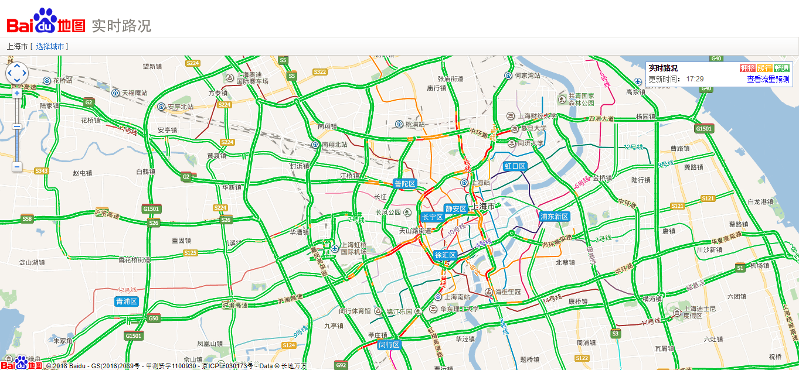
Real-time traffic
Notes:
http://map.baidu.com/fwmap/zt/traffic/?city=shanghai

Slide 22
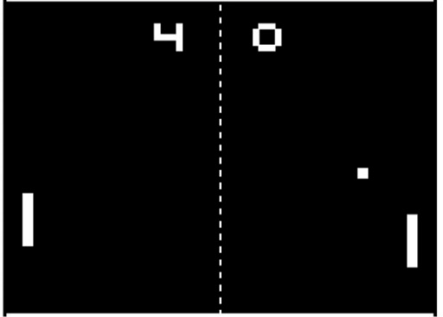
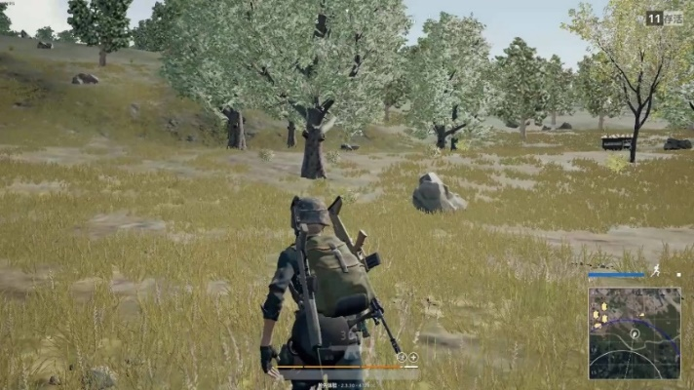
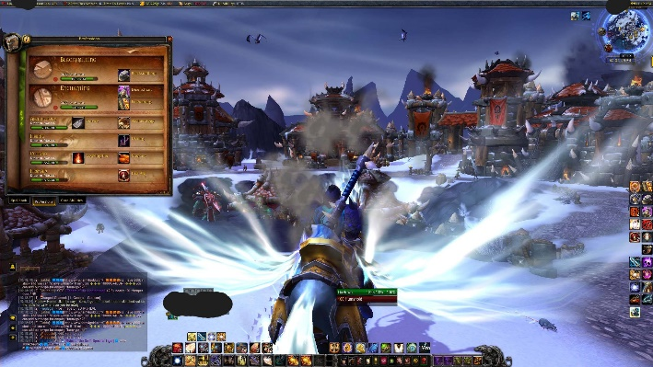
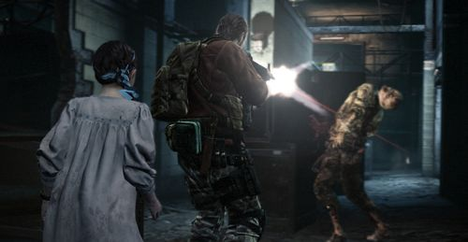

Video games
Games have evolved for a long time.
Wii, PlayStation, Xbox 360 → Wii U, PlaySation 4, Xbox One
Games combining 3D techniques
Single/multiple players

Slide 23
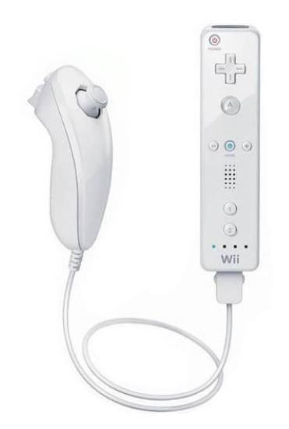
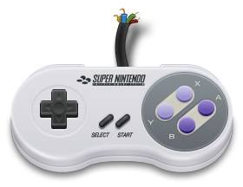
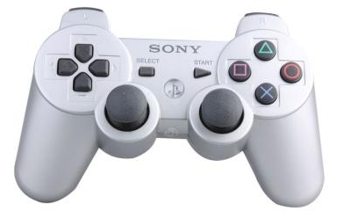
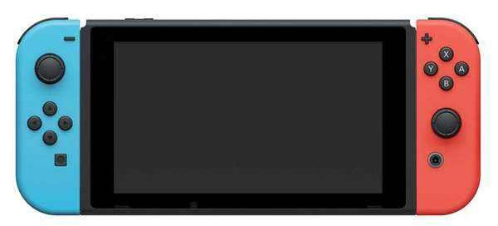
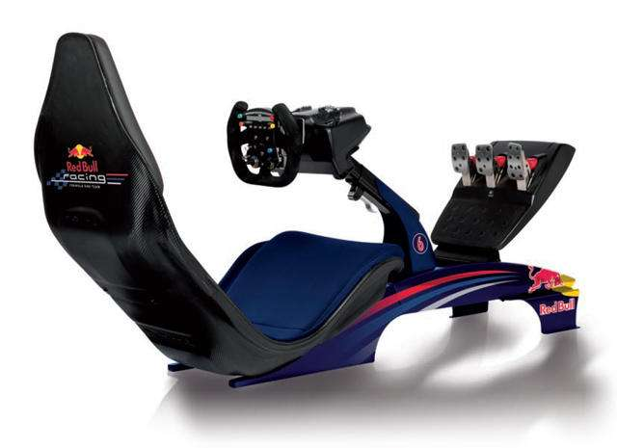
Video games
Wii, Xbox: natural user interface
Notes:
Labo宣传片：https://v.qq.com/x/page/m0025obhxiz.html

Slide 24
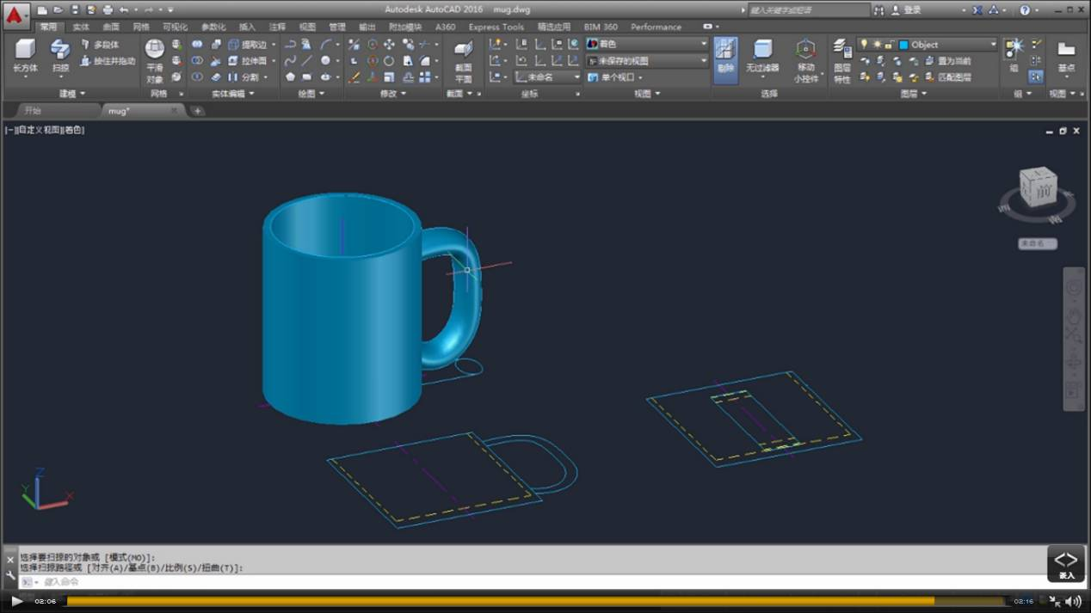
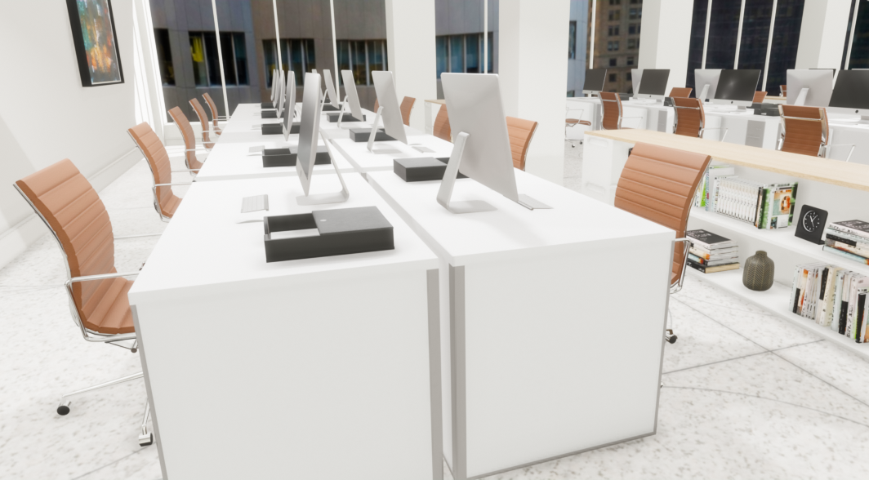
Computer-aided design and fabrication
Notes:
https://depot.floored.com/scenes/Vornado_90-Park-Avenue_Interior-Offices_7th-Floor/

Slide 25
Outline
Introduction
What is direct manipulation
Some examples
2D and 3D interfaces
Teleoperation and presence
Augmented and virtual reality

Slide 26
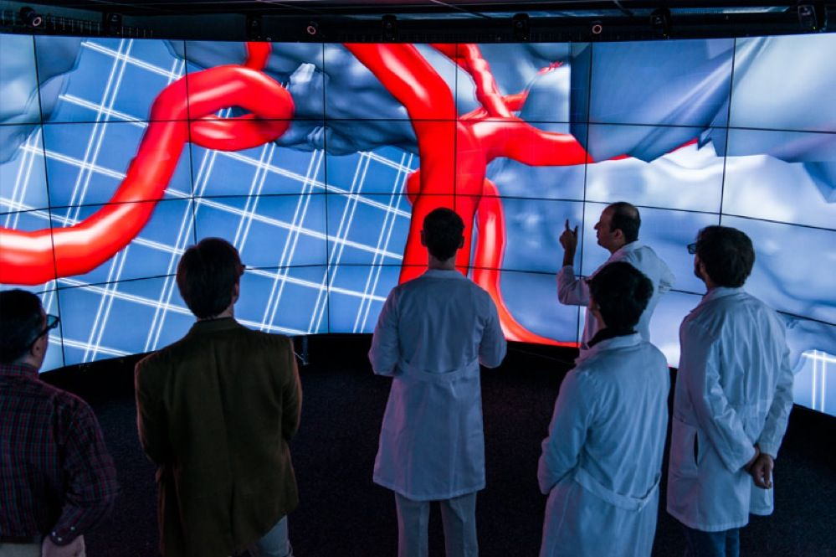
2D and 3D interfaces
3D interfaces are more natural than 2D interfaces
“Enhanced” interfaces improve user experiences
Flying through objects, multiple simultaneous views of objects...
Notes:
https://www.nsf.gov/news/news_summ.jsp?cntn_id=126209
https://www.nsf.gov/news/news_images.jsp?cntn_id=126209&org=NSF

Slide 27
2D and 3D interfaces
Guidelines for inclusion of enhanced 3D features:
Provide overviews
Allow teleportation
Offer x-ray version vision
Provide history keeping
Permit rich user actions on objects
Enable remote collaboration
Give users control over explanatory text and let them view details on demand

Slide 28
2D and 3D interfaces
Guidelines for inclusion of enhanced 3D features (Cont.):
Offer tools to select, mark, and measure
Implement dynamic queries to rapidly filter out unneeded items
Support semantic zooming and movement
Enable landmarks to show themselves even at a distance
Allow multiple coordinate views
Develop novel 3D icons to represent concepts

Slide 29
Outline
Introduction
What is direct manipulation
Some examples
2D and 3D interfaces
Teleoperation and telepresence
Augmented and virtual reality

Slide 30
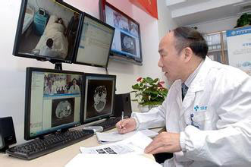
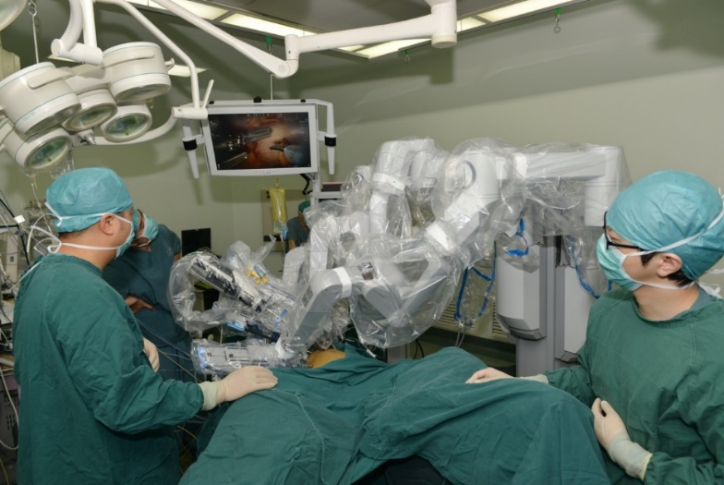
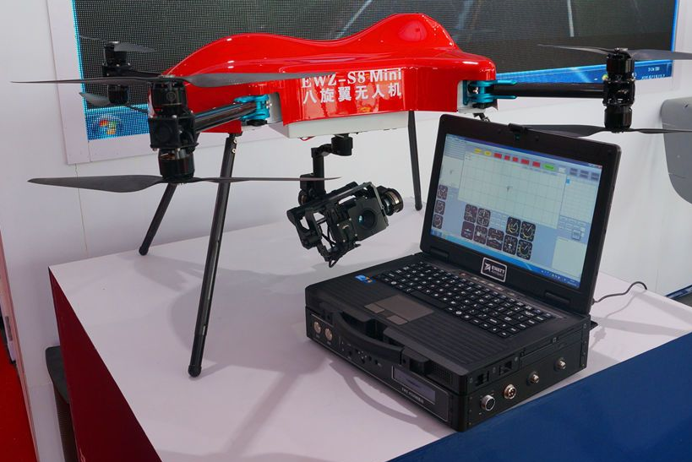
Teleoperation
Teleoperation/Remote control
Examples include
Scientific applications in space, underwater, or in hostile environments
Drones
Teleoperation is commonly used by the military and by civilian space projects
Direct manipulation
Process control
Teleoperation
Notes:
http://club.xywy.com/zixun/d36288.html?cat=15
2015年3月27日深夜，达芬奇（da Vinci）手术机器人正式进驻北京大学人民医院。经过安装调试，4月1日手术机器人正式投入使用。由胃肠外科叶颖江主任“主刀”的北京大学人民医院首例达芬奇机器人辅助下的直肠癌根治术取得圆满成功。达芬奇机器人使手术更加精准、微创，提高手术治疗效果，既避免了传统开腹进行腹部肿瘤根治术带来的创伤，又克服了腹腔镜手术器械的局限性，给外科领域带来了革命性的突破。

Slide 31
Teleoperation
Factors affect remote environments
Time delays
Incomplete feedback
Unanticipated interferences

Slide 32
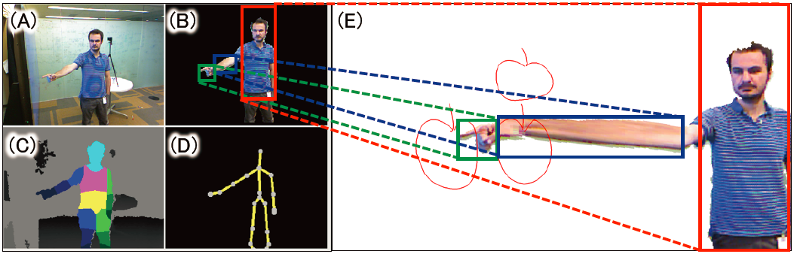
Telepresence
ImmerseBoard allows two users to be co-located and work on the same shared screen

Slide 33
Outline
Introduction
What is direct manipulation
Some examples
2D and 3D interfaces
Teleoperation and presence
Augmented and virtual reality

Slide 34
AR/VR
Virtual reality breaks the physical limitations of space and allow users to act as though they were somewhere else
Augmented reality shows the real world with an overlay of additional overlay
Situational awareness shows information about the real world that surrounds you by tracking your movements in a computer model
Augmented reality is an important variant
Enables users to see the real world with an overlay of additional interaction.

Slide 35
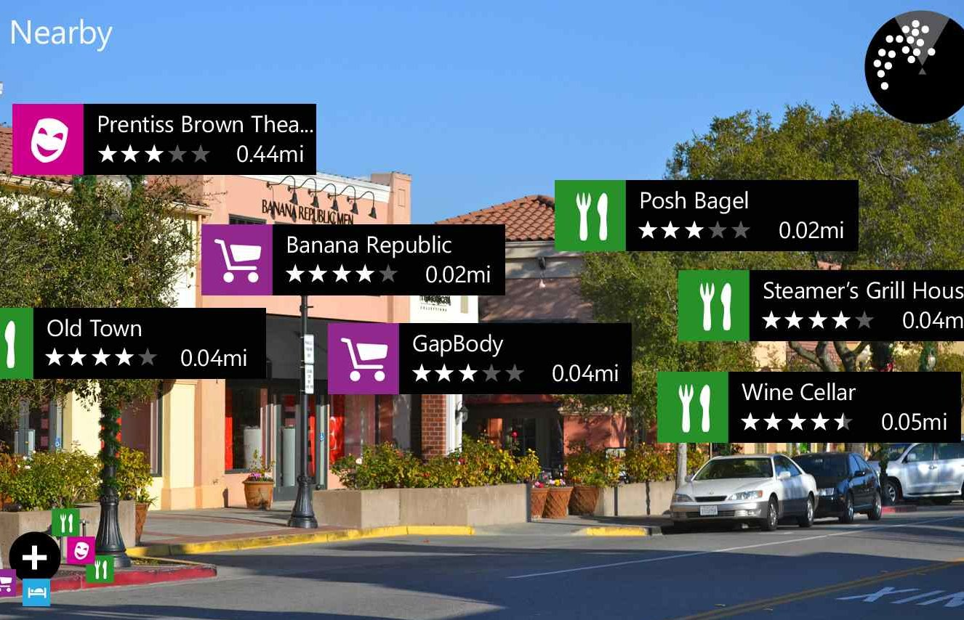
Augmented reality
Using augmented reality overlays, various points of interest can be shown on a mobile phone
Icons represent the type of place (food, shopping, etc.) and distances from the current location
Links are provided to user reviews

Slide 36
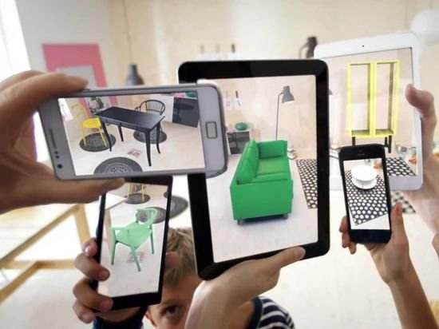
Augmented reality
Customers can use their personal mobile devices to pull up objects from the IKEA Catalog and see how the various items would look in their own house (Apple Store: IKEA Place)

Slide 37
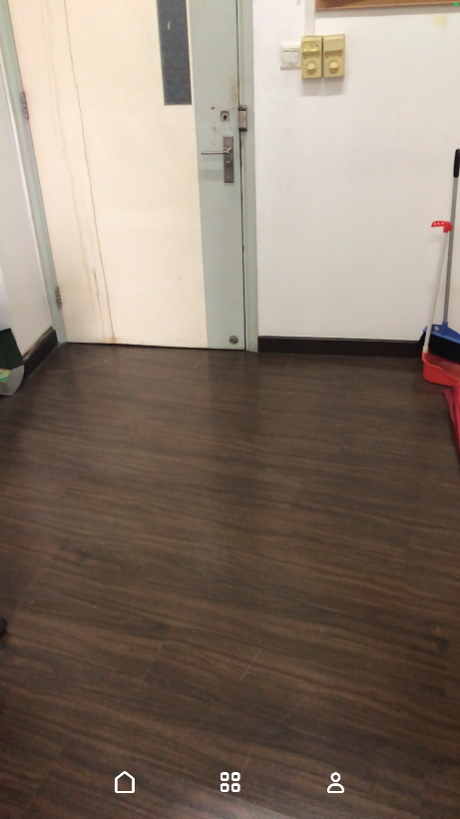
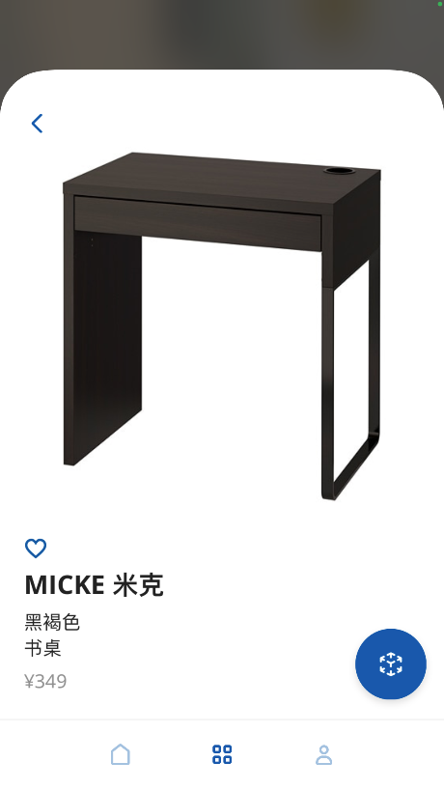
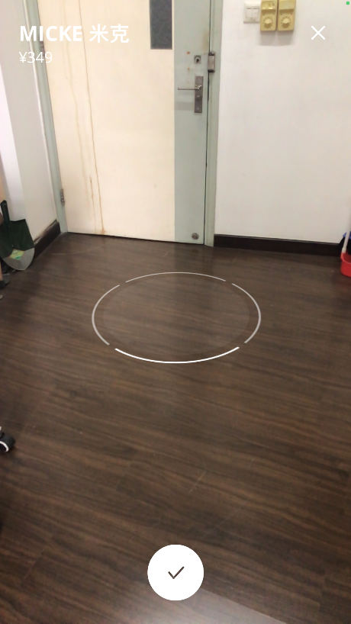
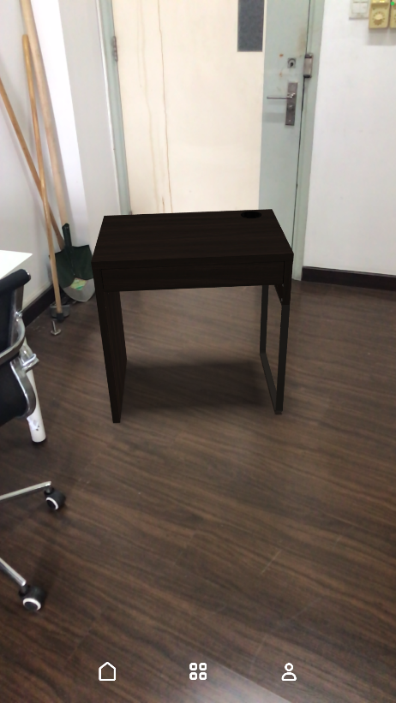
Augmented reality
Customers can use their personal mobile devices to pull up objects from the IKEA Catalog and see how the various items would look in their own house (Apple Store: IKEA Place)

Slide 38
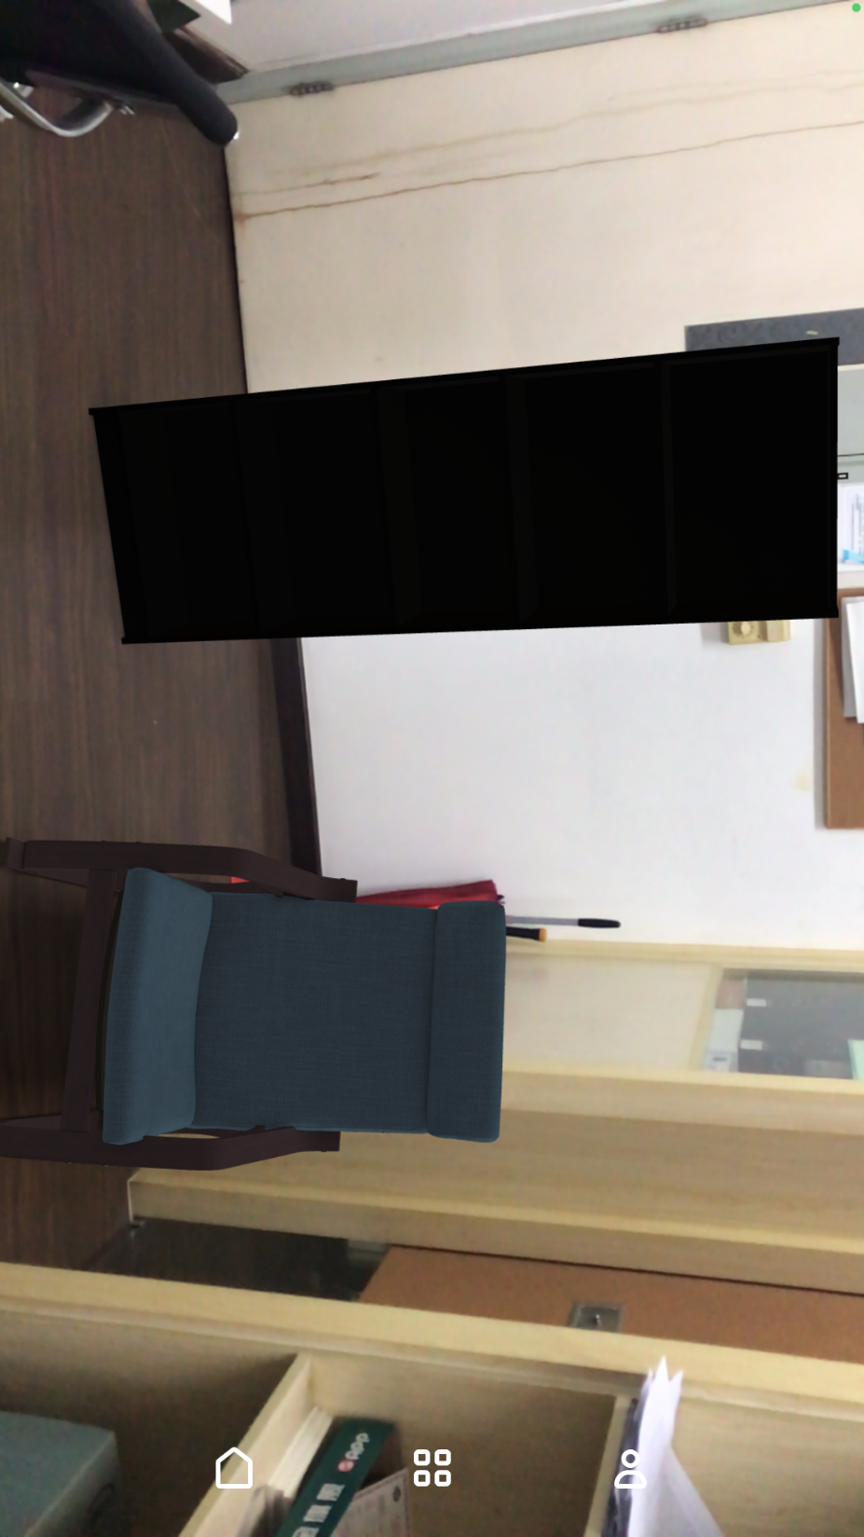
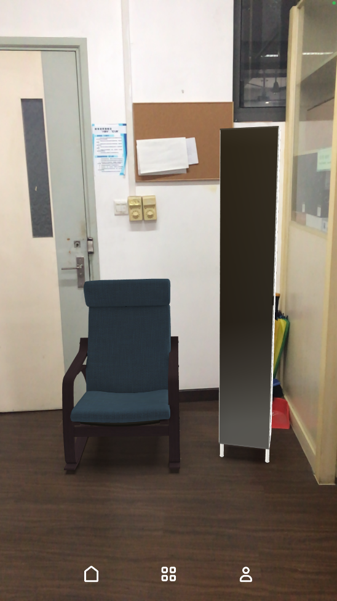
Augmented reality
Customers can use their personal mobile devices to pull up objects from the IKEA Catalog and see how the various items would look in their own house (Apple Store: IKEA Place)

Slide 39
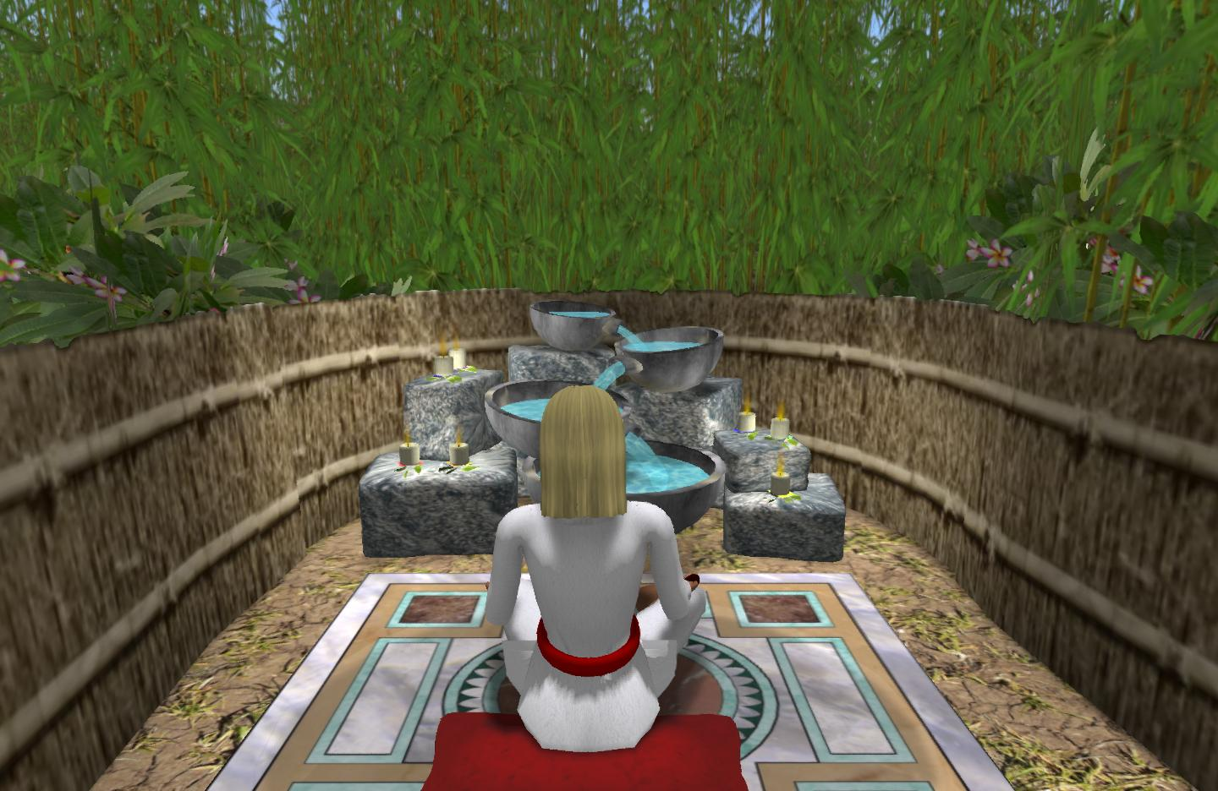
Virtual reality
Image of a virtual meditative world that users can use for engaging in meditation activities
The virtual world has sounds
They change with each chakra (stage) of the meditation process
This is an application of positive computing

Slide 40


CAVE
Cave automatic virtual environment
Notes:
CAVE(Cave Automatic Virtual Environment)是一种基于投影的虚拟现实系统，它由围绕观察者的四个投影面组成，如下图所示。四个投影面组成一个立方体结构，其中三个墙面采用背投方式，地面采用正投方式。（通常使用反射镜以节省空间）
观察者戴上液晶立体眼镜和一种六个自由度的头部跟踪设备，以便将观察者的视点位置实时反馈到计算机系统和体验身临其境的感觉。当观察者在CAVE中走动时，系统自动计算每个投影面正确的立体透视图象。同时，观察者手握一种称为Wand的传感器，与虚拟环境进行交互。

